Slide 1
Predicting Breast Cancer using machine learning

Slide 2
Line Of Action:
Importing Libraries
Importing Datasets
Split dataset into attributes using iloc
Splitting dataset into train and test dataset
Training and Prediction
Evaluating the Algorithm

Slide 3
Importing Libraries and Dataset

Slide 5
ERROR 404:
NO NULL VALUES FOUND

Slide 6
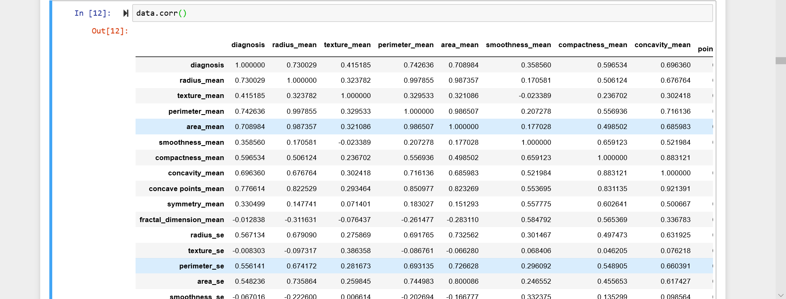
Correlation

Slide 7
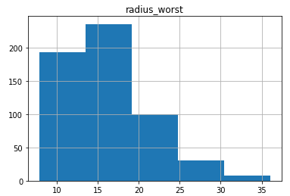
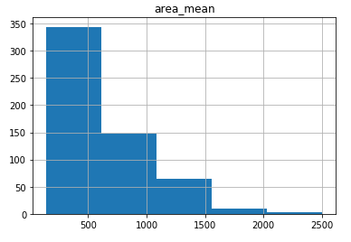
DATA VISUALISATION Histograms:-

Slide 8
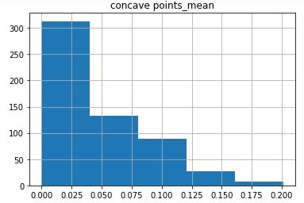
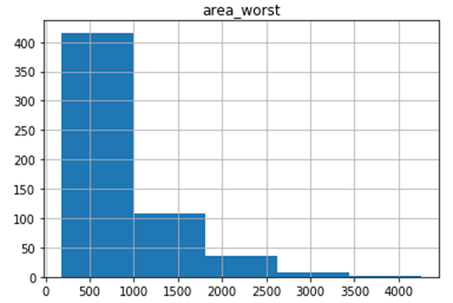

Slide 9
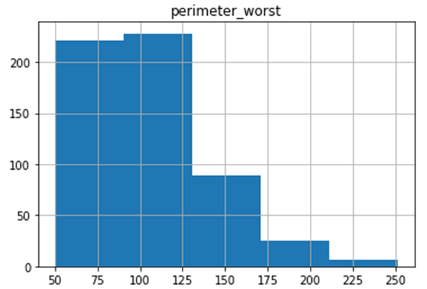
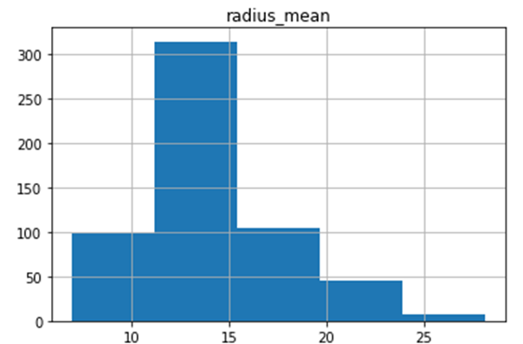

Slide 10
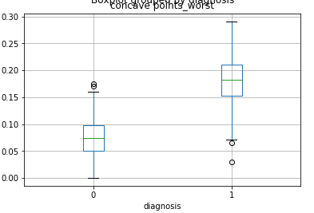
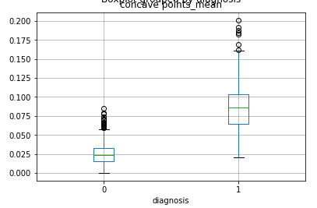
BoxPlots:-

Slide 11
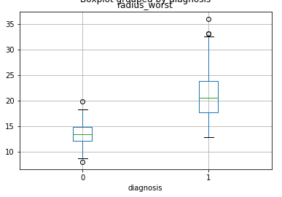
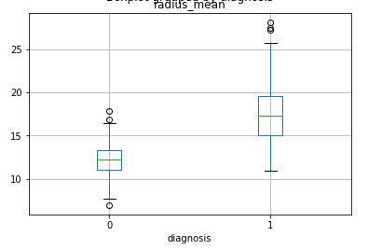

Slide 12
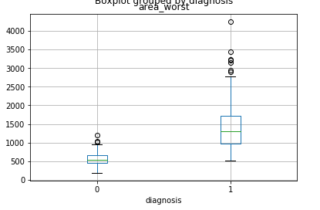
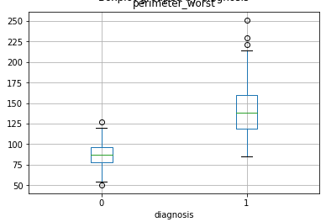

Slide 13
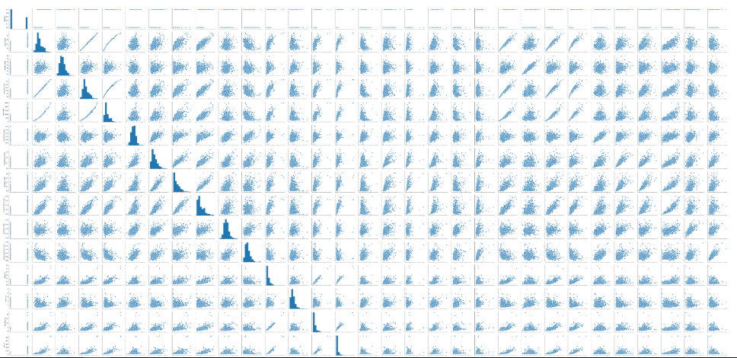
Pair plots

Slide 14
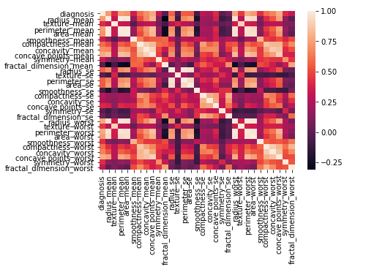
Heatmap

Slide 15

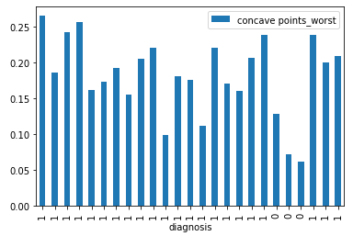
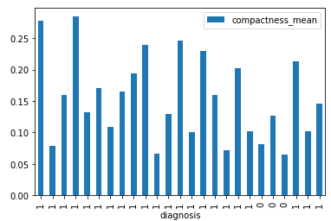
Bar graphs

Slide 16


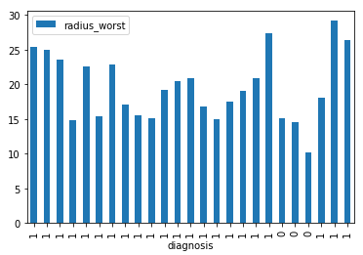
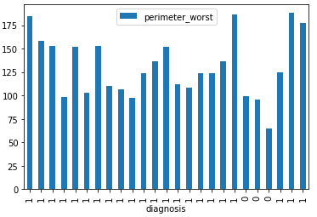

Slide 17
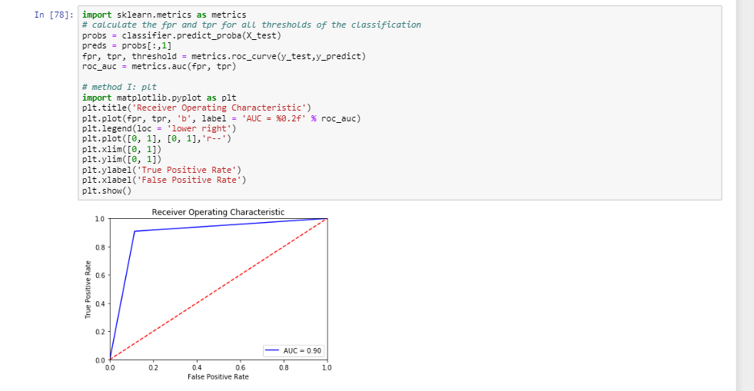
ROC Curve

Slide 18
Splitting Attributes
USING iloc

Slide 20
splitting Dataset into Training and Testing.

Slide 22
Why did we choose all the Attributes as Predictors?

Slide 23
We choose all the attributes as predictors because
All the attributes given are at a good correlation with diagnosis of breast cancer
These values are from cancer reports.
\.

Slide 24
Training & prediction
Let’s start with the first set of slides

Slide 25
S. No | Algorithms | Accuracy1
1 | Logistic Regression | Train - 94%
 |  | Test – 92%
2 | Decision Tree | Train – 100%
 |  | Test – 88%
3 | Random Forest | Train – 99%
 |  | Test – 93%
4 | Support Vector Classification | Train – 100%
 |  | Test – 58%
5 | Naive Bayes | Train – 94%
 |  | Test – 92%
6 | K- Nearest Neighbours | Train – 94%
 |  | Test – 93%

Slide 26
Evaluating the Algorithm

Slide 27
For KNN
Data Splitting | Train(%) | Test(%) | Accuracy(%)
90-10 | 95 | 89 | 89
80-20 | 94 | 93 | 93
70-30 | 93 | 94 | 94
60-40 | 93 | 95 | 95
50-50 | 94 | 93 | 93

Slide 28
Precision and Recall
Precision | Recall
91.6% | 93.6%

Slide 29
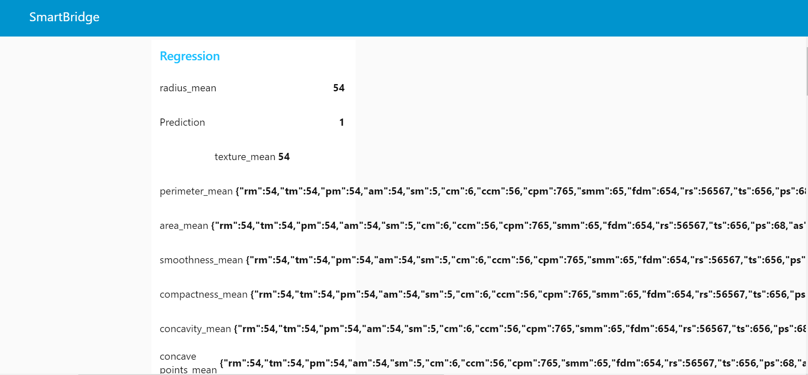
Results

Slide 30

Work by Team Cosmos
Madhuri
Sahil Shaik
Vamsi Krishna
Sai Kiran
Sarath Reddy

Slide 31
Thank You
Team COSMOS

